Slide 1



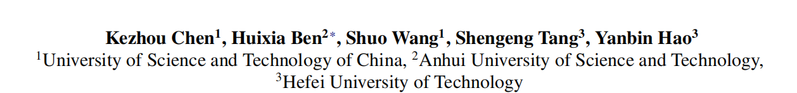





Chongqing University of Technology
ATAI
Advanced Technique of Artificial Intelligence
Chongqing University of Technology
Mixture of Multimodal Adapters for Sentiment Analysis
Code：https://github.com/MMA4MSA/MMA
—— ACL 2025
Reported by ZhiWei Xu

Slide 2
Motivation
(1) The fusion strategies of these recent methods are similar to those of traditional multimodal recognition methods which focus on achieving a more comprehensive fusion of multimodal fe-atures. While the MSA task needs to analyze the emotion hidden in vision and audio, where
both visual and audio modalities may include noise and task-irrelevant features, such as
background movements in videos and ambient noise in audio recordings .Consequently,
analyzing irrelevant or misleading features can impede the accurate assessment of emotional states .
(2) These methods and their modules are fully fine-tuned to cater to multimodal representations.Although this strategy has brought great performance advantages over training from scratch, it has become a resource-consuming and parameter_x0002_inefficient process with increasing models and data.

Slide 3
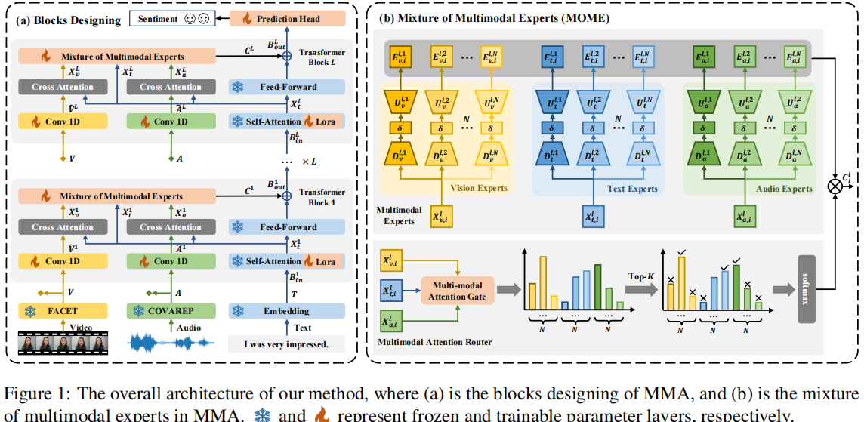
Method

Slide 4

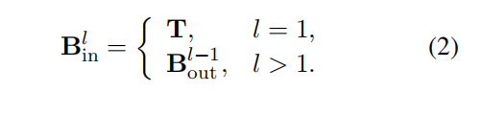


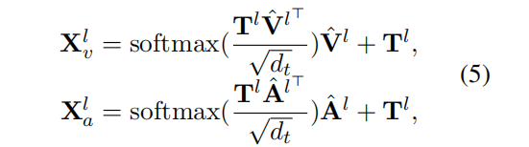
Method

Slide 5



Method

Slide 6




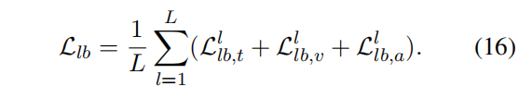
Method

Slide 7
Method

Slide 8
Method

Slide 9


Method

Slide 10
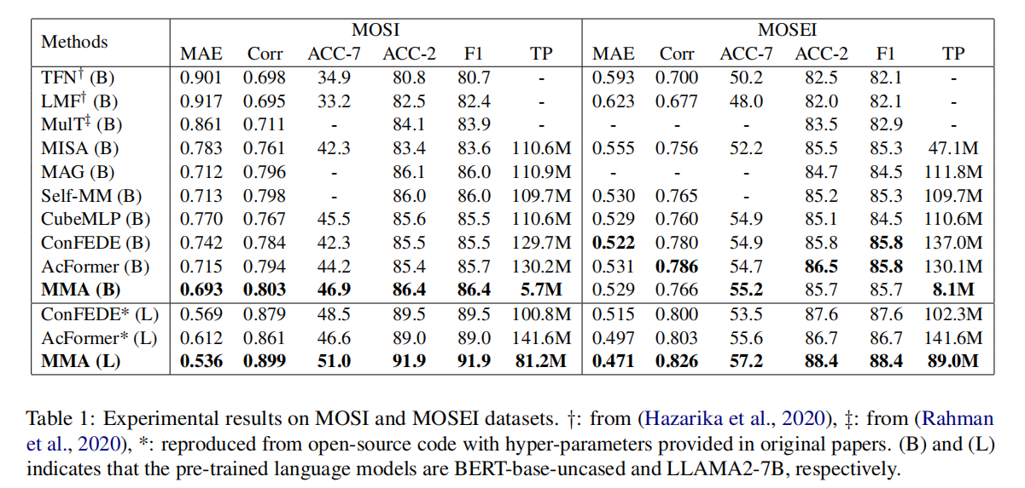
Experiments

Slide 11
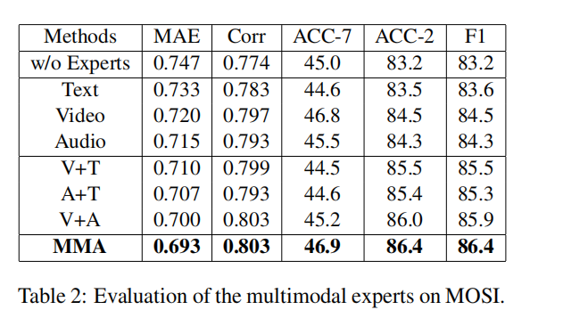
Experiments

Slide 12
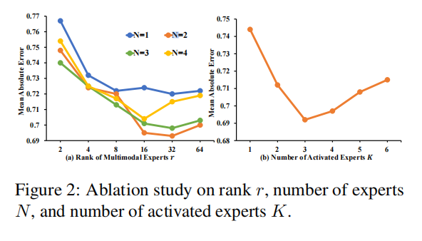
Experiments

Slide 13
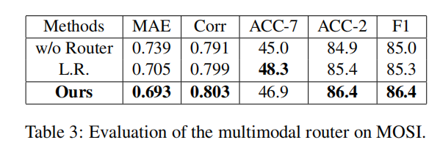
Experiments

Slide 14
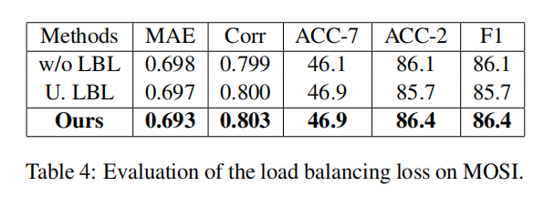
Experiments

Slide 15
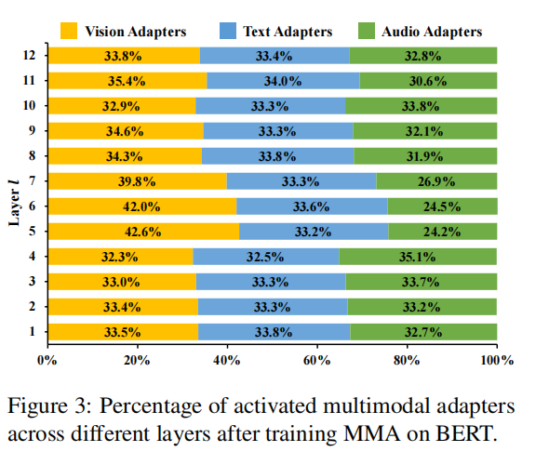
Experiments

Slide 16
Thanks!

